Slide 1
Heat sensor
Graduation project
Hossam Raafat – Q7

Slide 2
Introduction
In this project we are going to design a circuit for measuring temperature. This circuit is developed using “LM35”, a linear voltage sensor. Temperature is usually measured in “C”.
LM35 is three pin transistor like device.
It has VCC, GND and OUTPUT. This sensor provides variable voltage at the output based on temperature.
for every +1 C raise in temperature there will be +10mV higher output. So if the temperature is 0◦c the output of sensor will be 0V, if the temperature is 10◦c the output of sensor will be +100mV, if the temperature is 25◦c the output of sensor will be +250mV.
So for now with LM35 we get temperature in the form of variable voltage. This temperature dependent voltage is given as input to ADC (Analog to Digital Converter) of ATMEGA32A. The digital value after conversion obtained is shown in the 16x2 LCD as temperature.

Slide 3
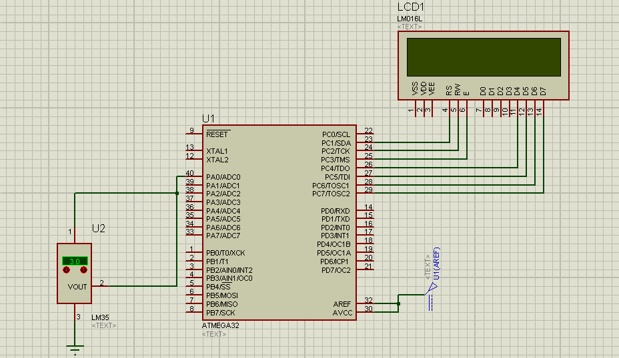
Hardware Circuit Diagram

Slide 4
Hardware Components
ATMEGA32 Microcontroller
LCD LM016L
DC source 1.5 V
LM35 Temperature Sensor.
Software
Atmel studio
Proteus for simulation

Slide 5
Circuit Diagram and Explanation
In the circuit, PORTC of ATMEGA32 is connected to data port of LCD.
In the circuit you can see we have used 4bit communication (D4-D7).
In ATMEGA32A, we can give Analog input to any of eight channels of PORTA.
The Power reference is dc source 1.5 V

